Slide 1
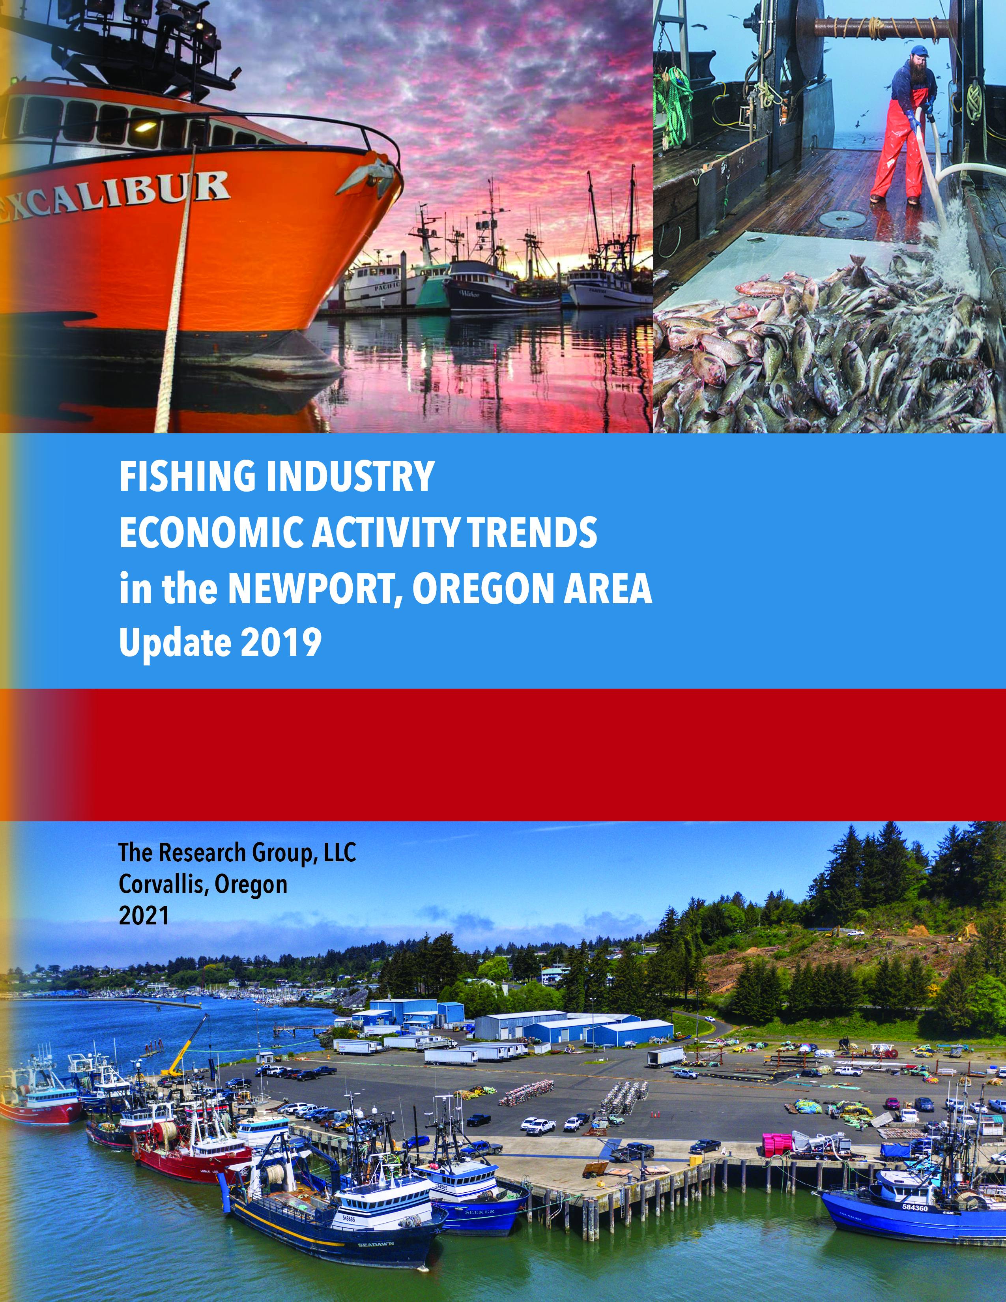
Fishing Industry Economic Activity Trends in the Newport, Oregon Area
Author:
Shannon Davis,
The Research Group, LLC
Sponsors:
Lincoln County Board of Commissioners
Midwater Trawlers Cooperative

Slide 2
Acknowledgements
Attributions:
Advisors:
Sponsor Representatives:
Harvester and processor interviews
Port of Newport and Port of Toledo interviews
Oregon Employment Department personnel
Oregon Department of Fish and Wildlife personnel
Gil Sylvia
Marine Resource Economist
Caroline Bauman
Economic Development Alliance of Lincoln County (retired)
Heather Mann,
Executive Director Midwater Trawlers Cooperative
Kaety Jacobson
Lincoln County Commissioner

Slide 3
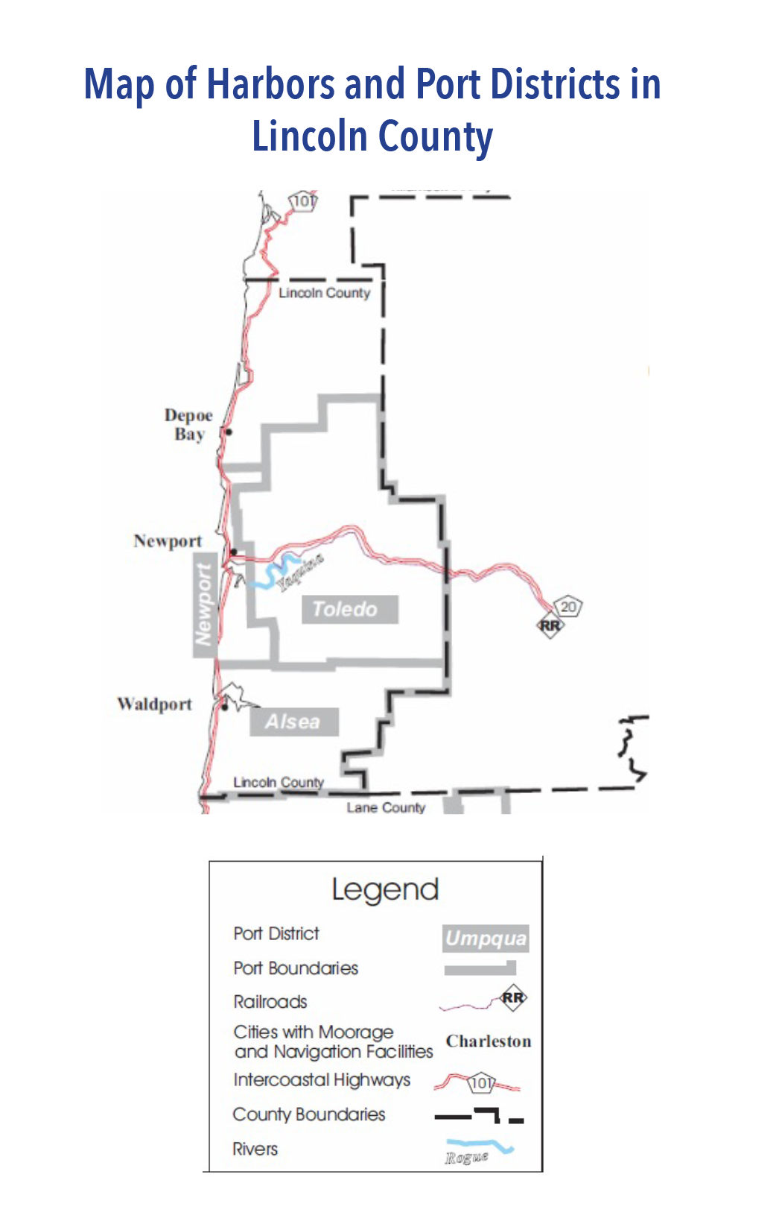
Area of Focus: Newport Area
Review of commercial landings and related items are typically aggregated into port groups. For consistency, the Newport area includes all harbors in Lincoln County.

Slide 4
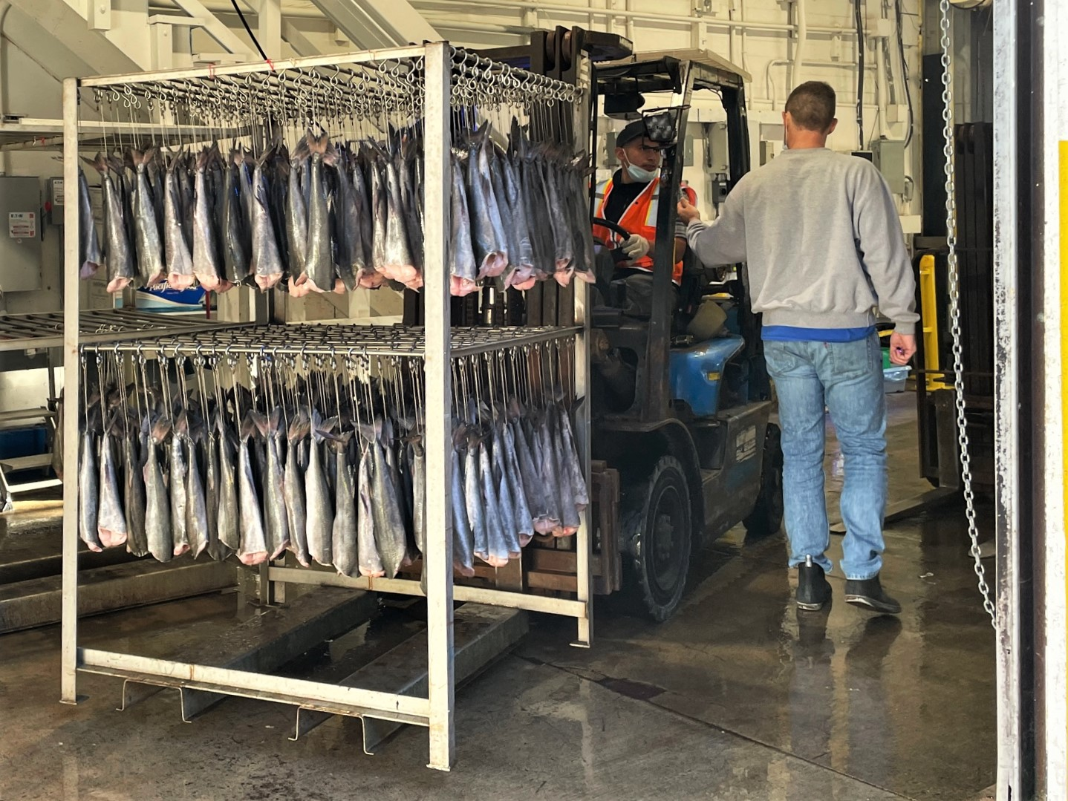
Key Indicators Considered
Commercial Fishing Activity
Recreational Fishing Activity
Related & Connected Activity, including
  Mariculture
  Boat Building & Related Work
  Gear Manufacturing
  Supply & Services
  Research & Education
  Natural Resource Management
  Enforcement
Economic Contribution
  Multiplier effect measured by:
    Income
    Jobs
    Output
  Comparisons to total economy in study area and state

Slide 5
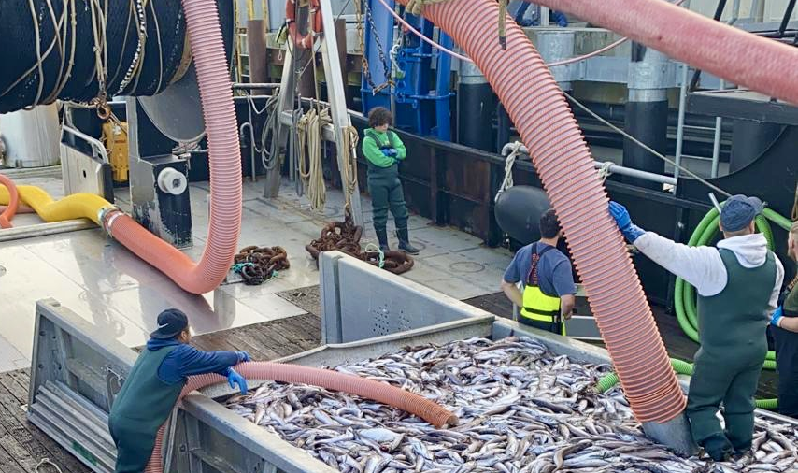
Key Findings

Slide 6
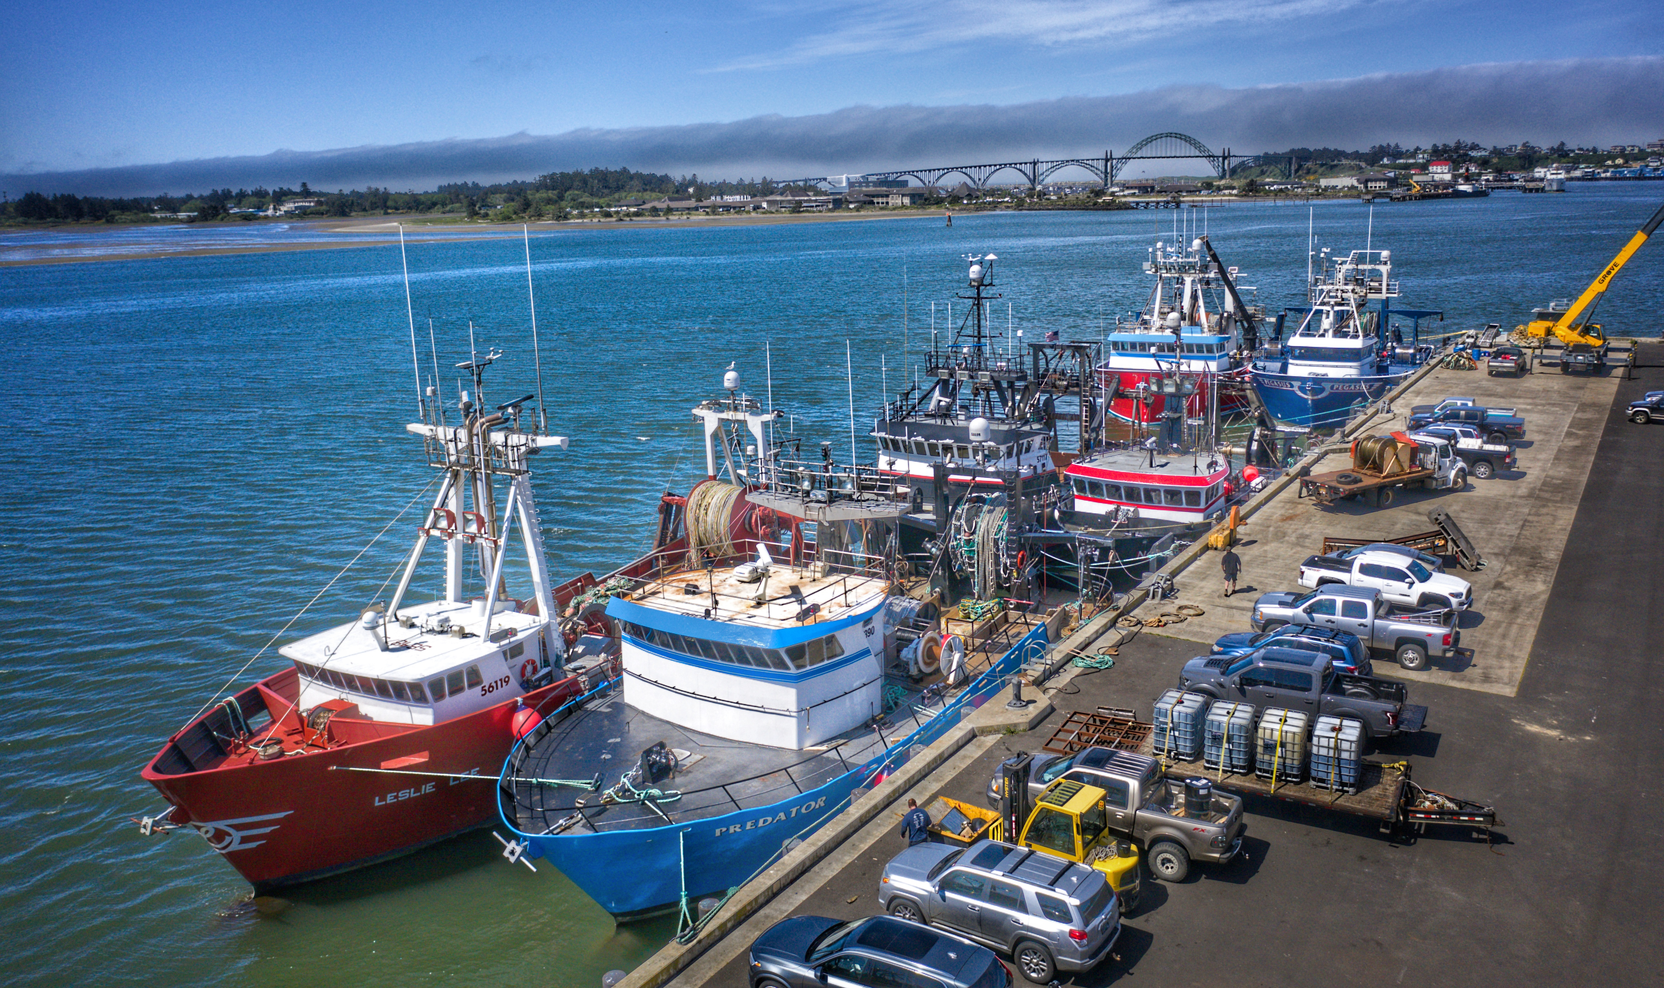
Commercial Fishing in 2019
331 commercial fishing vessels
264 were homeport vessels
4,788 deliveries in the Newport area
$59.3 million harvest value

Slide 7
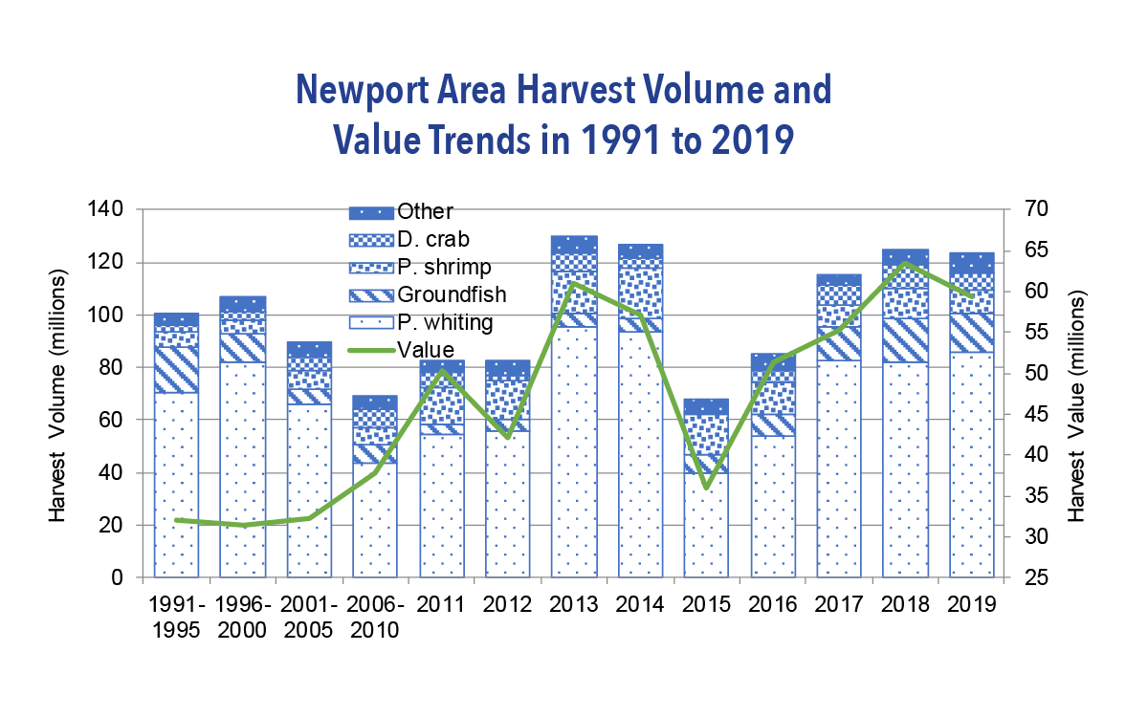
Newport Area Harvest Value by Fishery (2019)
Dungeness Crab accounted for 42% of overall value.
Groundfish, including landed Pacific whiting, represented 31% of value.

Slide 8
Ex-Vessel Values in 2019
Newport Area:
$59.3 million
West Coast At-Sea:
$8.9 million
Alaska Onshore
& Offshore:
$1.9 billion

Slide 9
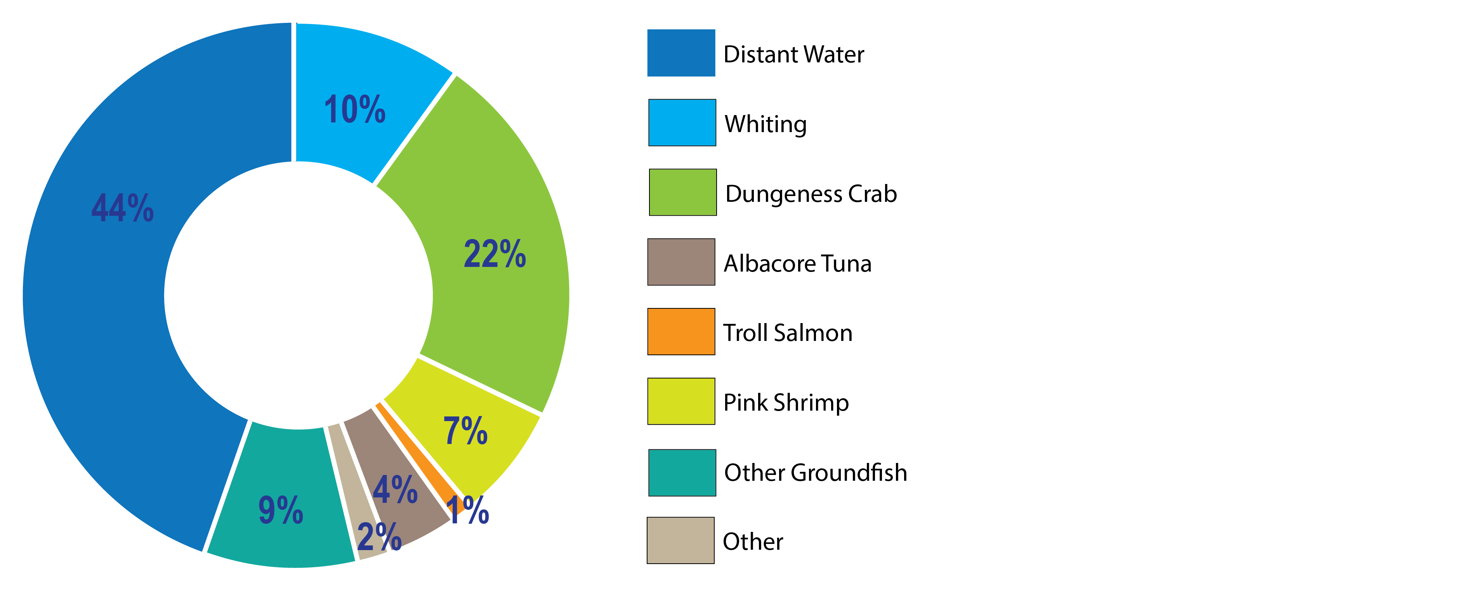
Economic Contributions by Ocean Onshore
Commercial Fisheries and Distant Water
Fisheries 2019
TOTAL INCOME
(millions)
Onshore $87
Distant Water $69
TOTAL $155

Slide 10
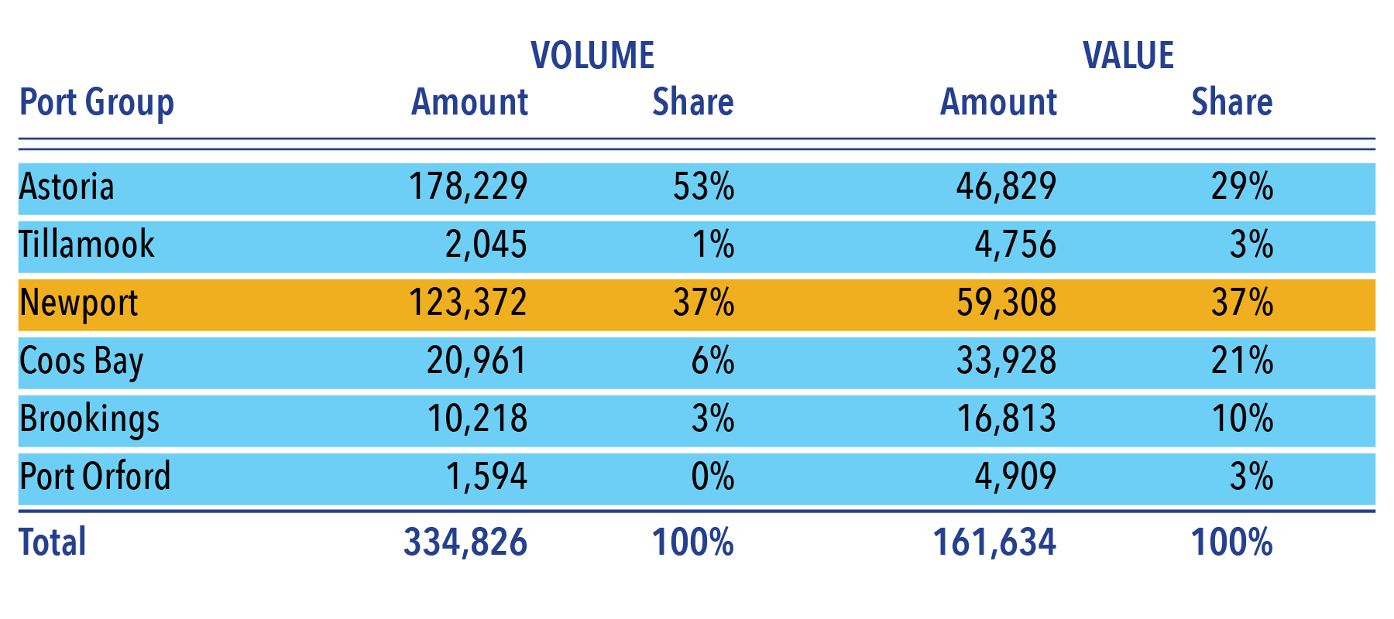
Onshore Harvested Volume and
Ex-Vessel Value (by Port Group – 2019)

Slide 11
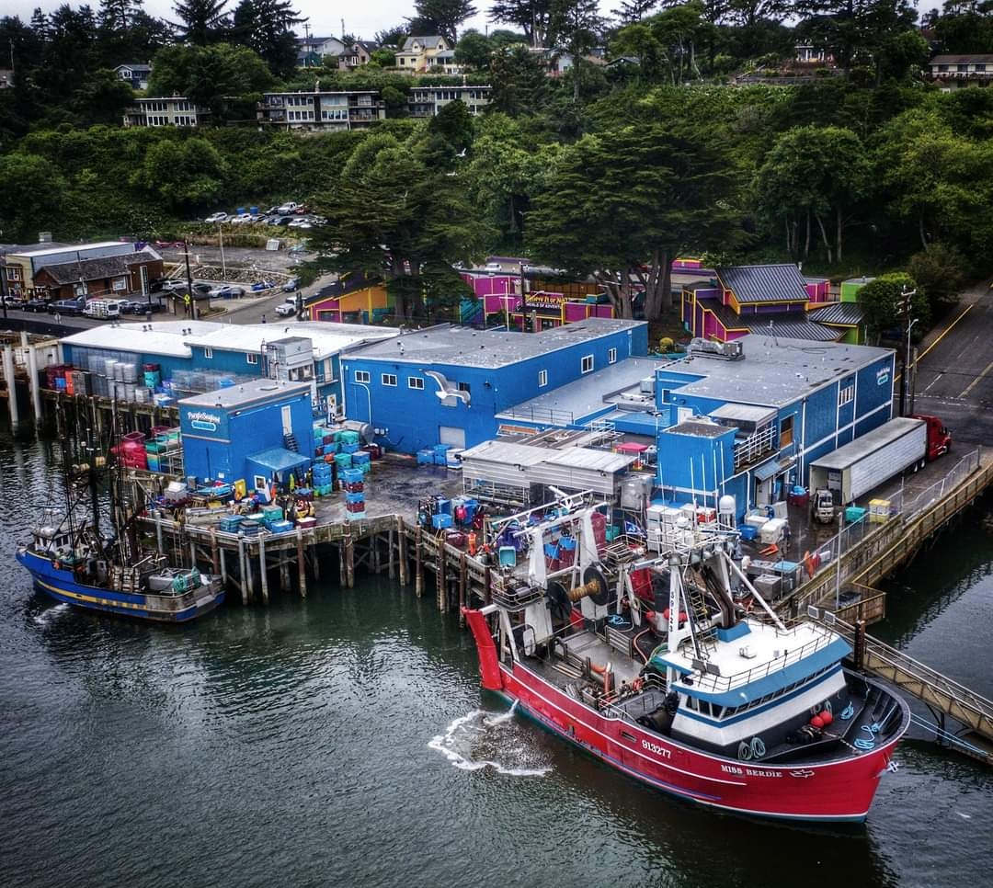
Local processing added $46 million in economic value

Slide 12

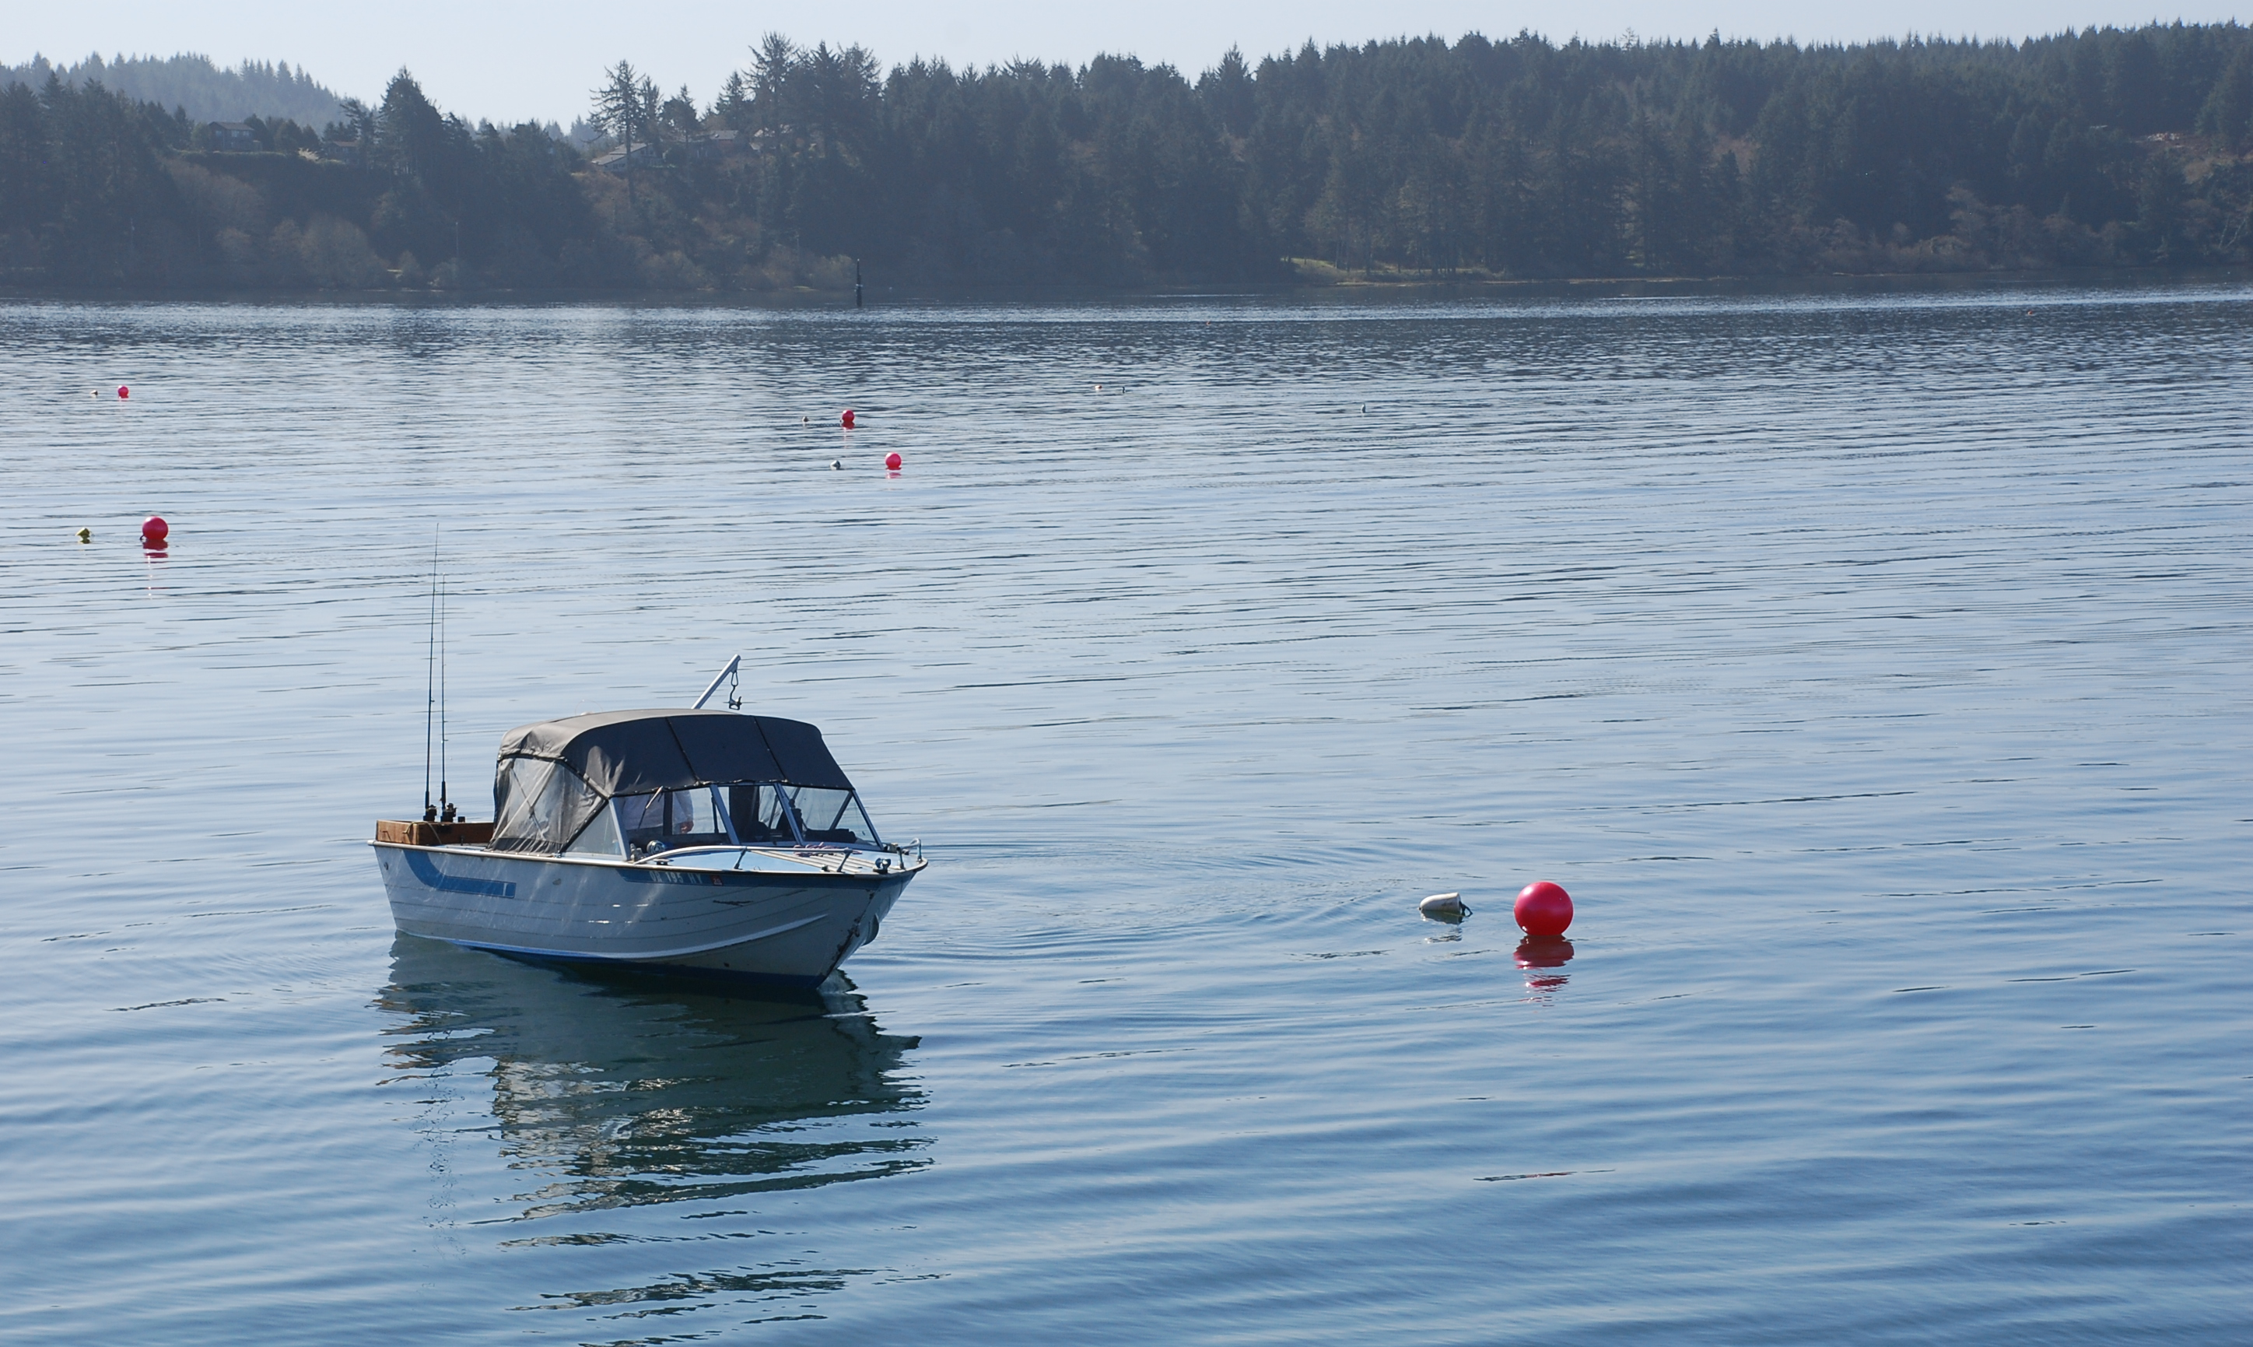
Recreational Fishing Contributions
Total ocean and lower river recreational spending in the Newport area was estimated at $23 million in 2019. Depoe Bay and Alsea Bay are important within this calculation.
*(Note: Spending from touring, like whale watching, was not included.)

Slide 13
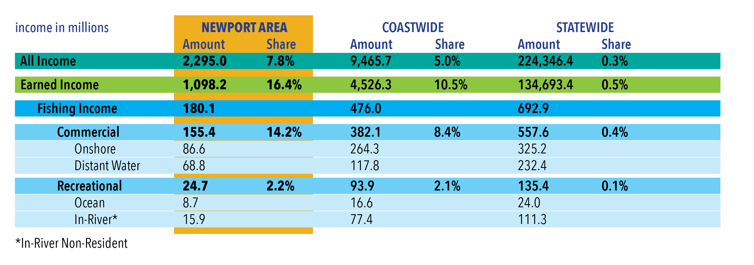
Income Snapshot from Commercial
& Recreational Fishing (2019)

Slide 14
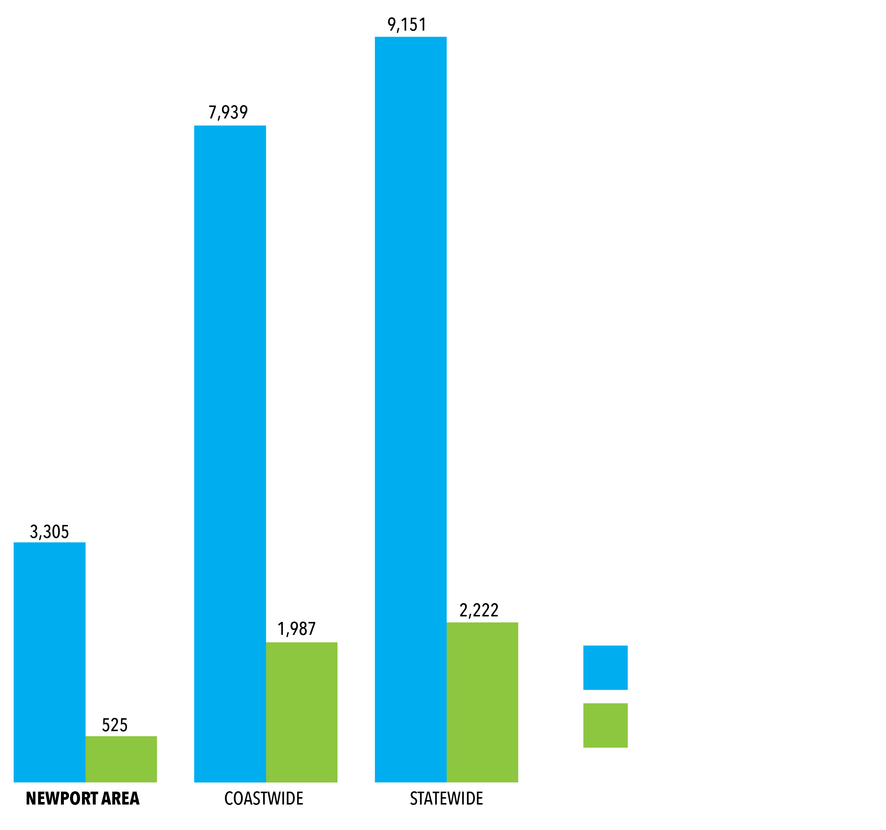
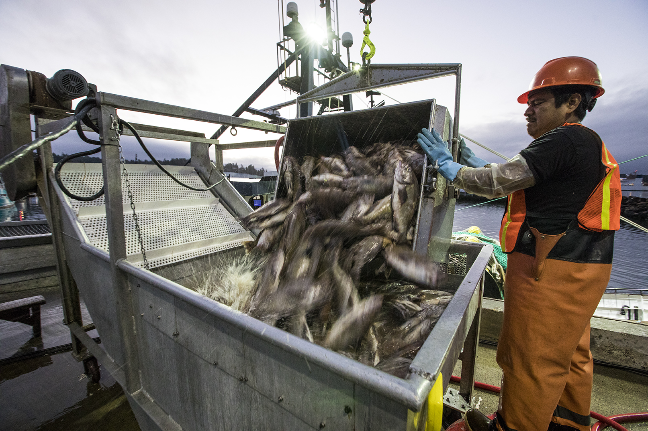
Jobs Snapshot from Commercial
& Recreational Fishing (2019)

Slide 15
Fishing’s Impact on Lincoln County Income
In 2012, Lincoln County commissioned a thorough economic study and this slide will show you the findings related to the sources of personal income.

Slide 16
Fishing’s Impact on Lincoln County Income
In 2012, fishing was 9.9% of Lincoln County’s earned income. Our 2019 figures show us that commercial fishing in Newport grew to 14.2% of earned income.

Slide 17

Trends in Income and Wages
The full report also provides an in-depth look, showing:
Lincoln County Personal Income from Net Earnings has been on a steady climb dating back to the 1980s
From 2003 to 2019, covered employment and wages rose through 2006, dropped 2011/12, and have grown steadily again since then.

Slide 18

Economic Take-Aways

Slide 19
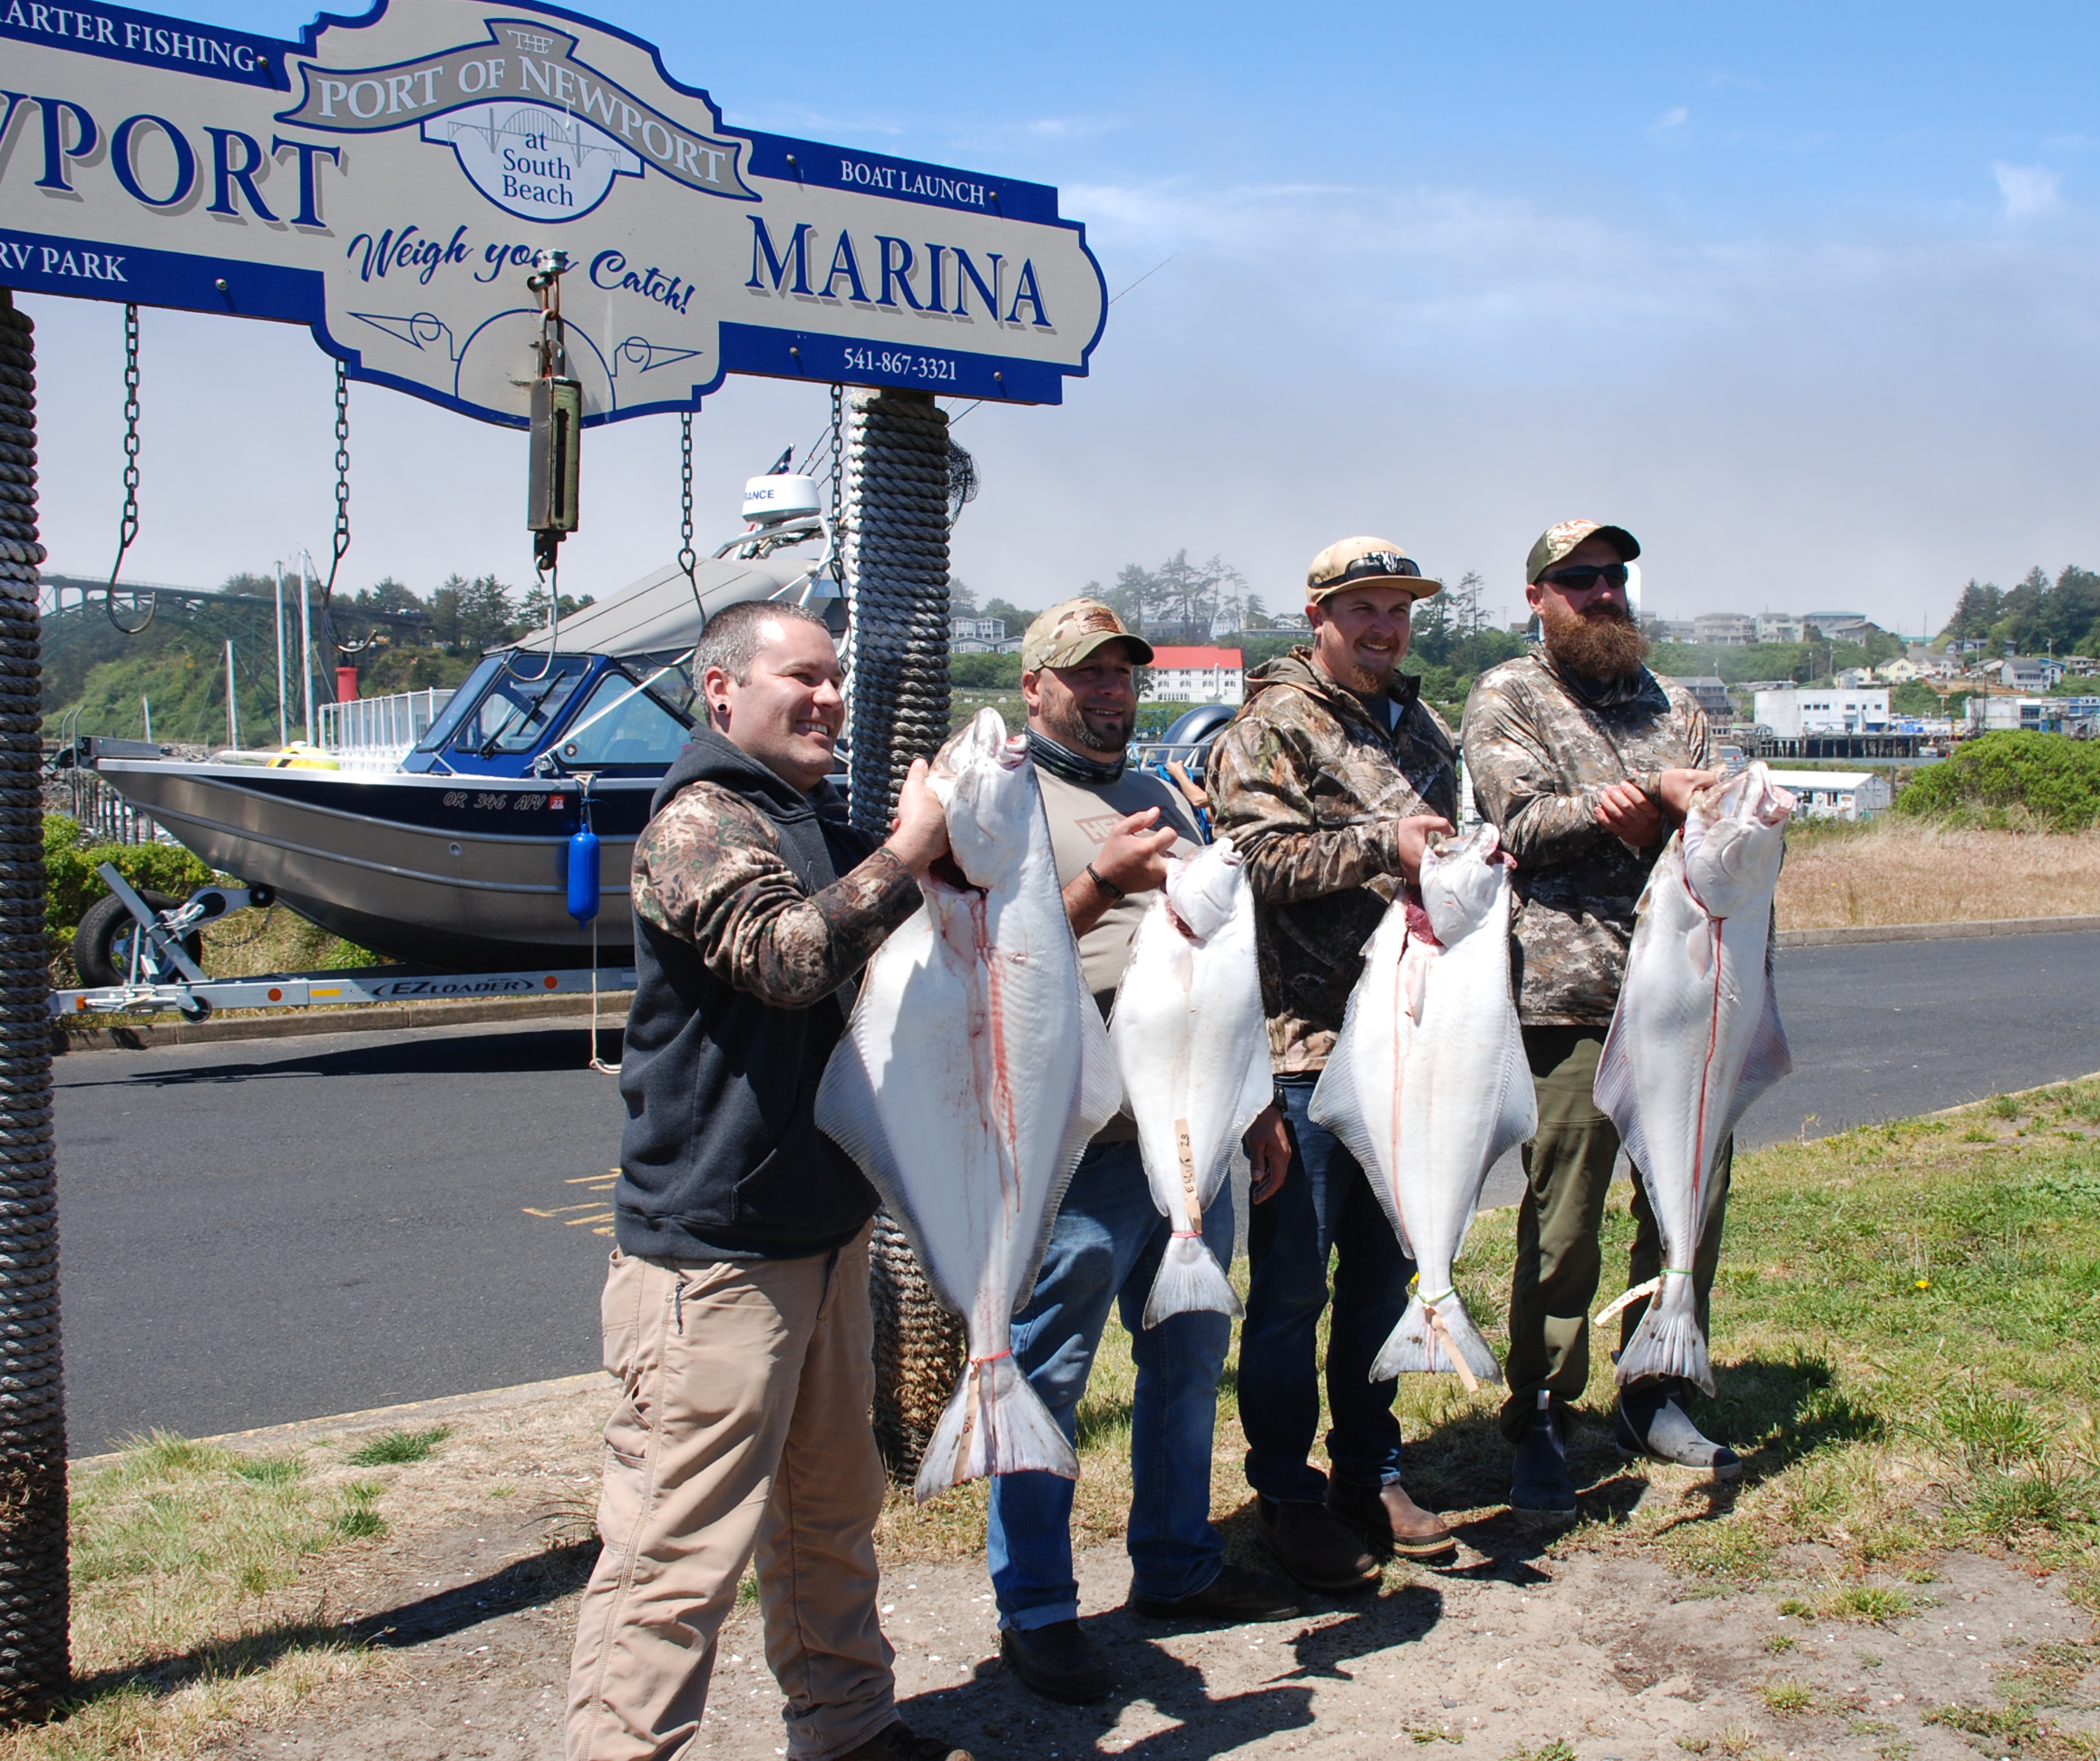
The total economic contribution from commercial and recreational fishing to the local economy was $176 million in income in 2019.

Slide 20
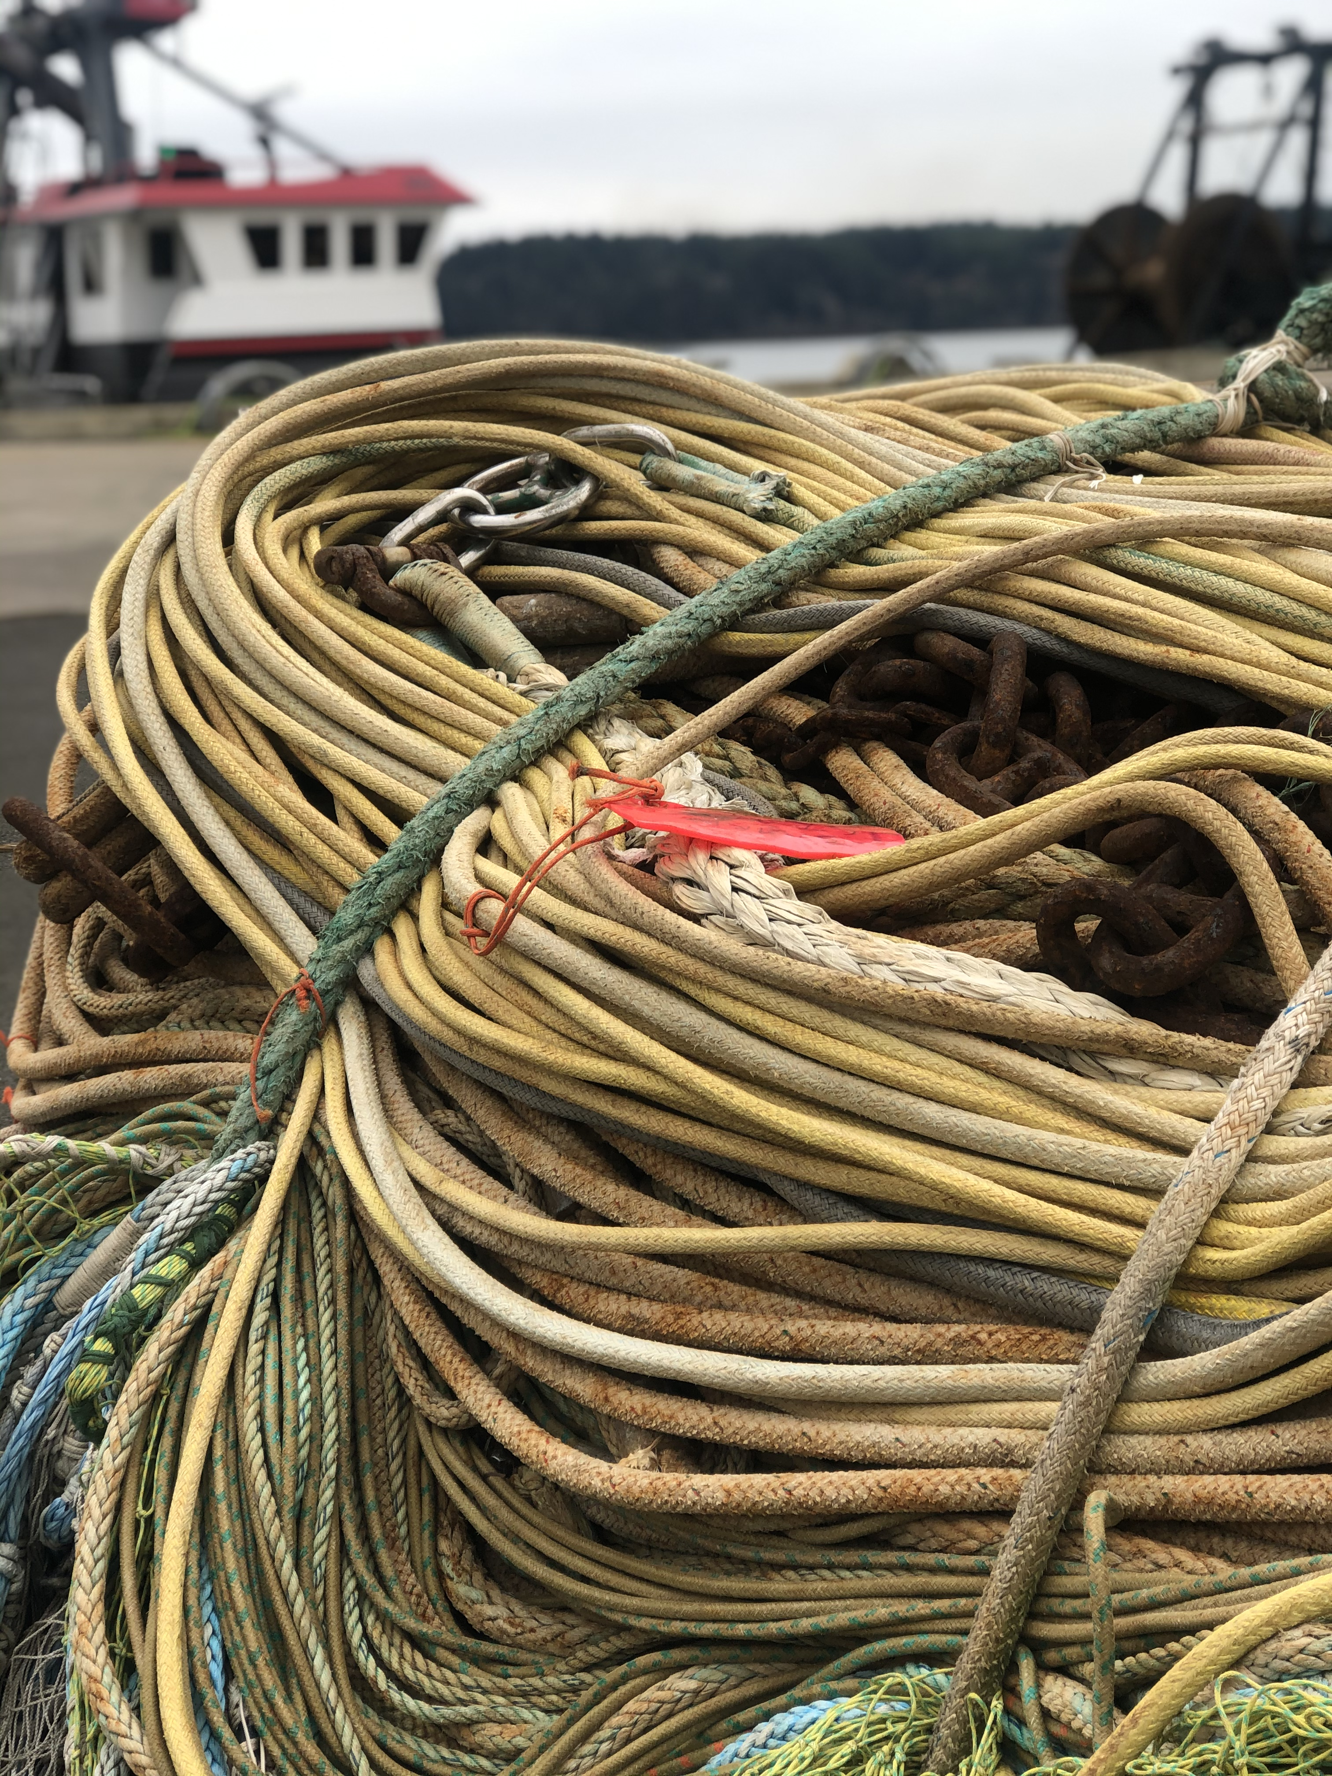
The same economic contributions at the State level economy is $245 million in income in 2019.
(This is higher because some purchasing occurs outside of Lincoln County)

Slide 21
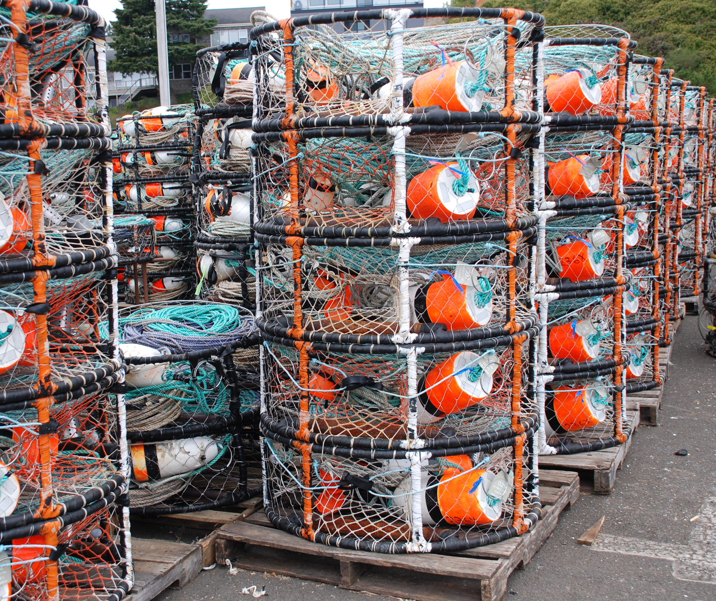
The economic contribution estimates for fishing industry related and connected activities represented another 18 percent of the area’s total annual earnings in 2012.

Slide 22
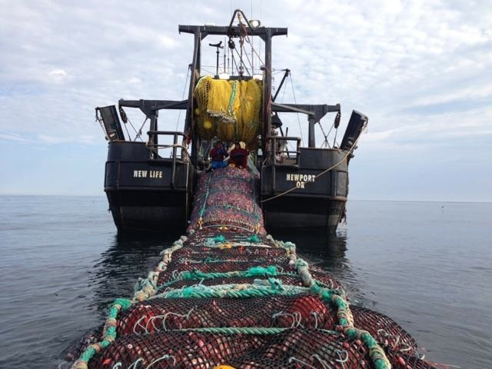

2019 Fishing
Industry Income
2012 related and connected activities income (adjusted for 2019 dollars)
Total Income of $346 million*
*This represents 7,400 jobs
=

Slide 23

Items for Discussion

Slide 24
There are pluses and minuses to consider when looking at single industry impacts and more detailed research and more complex analysis would be required to understand all economic and social linkages.
Fishing businesses add to local property tax base
Industry workers require housing, transportation, schools
Seafood processing requires a lot of fresh water
and discharge treatment which may challenge capacities
Fishing industry dominates water dependent zoned land in Newport area and land and improvements may have publicly desired alternative uses

Slide 25
A collaborative relationship must exist
between the public infrastructure
providers and the private sector for
the fishing industry to thrive.
There can be fundamental
infrastructure requirements for the
continuation and development of a
prospering fishing industry in the area
that falling short could signal
challenges for industry viability.

Slide 26
Fishing industry descriptions, while important in themselves for informing existing policy making bodies, should be part of further investigation and planning processes.
It will be helpful in keeping local government
plans current with a maritime industry centric
planning forum and program.
This would assist keeping the maritime
industry strong in the face of climate change,
new fish resource management approaches,
altered business regulations, and dynamic
seafood markets.

Slide 27
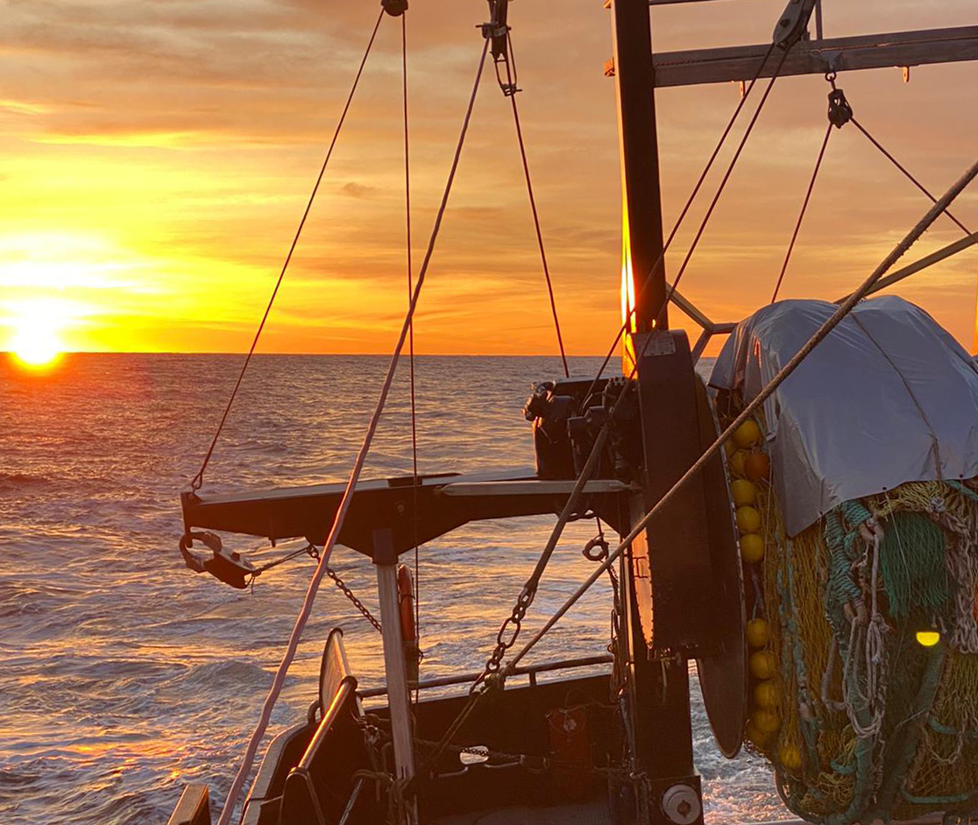
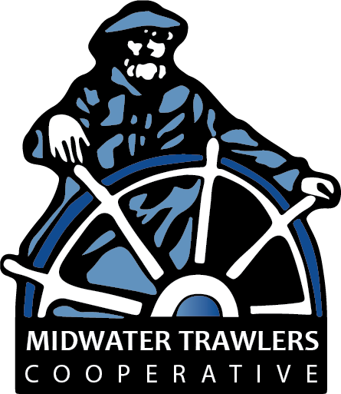
Final Thoughts & Questions?

